Slide 1
Introduction to Java for Business BU350.700.51 Spring I 2025
Java Variables & Data Types

Slide 2
What You Will Learn
Declaring & initializing variables
Rules for constructing variable names
Java primitive types
Java type conversions

Slide 3
Java Variables
Variables are used in programs to store information while the program is running
Java uses 3 kinds of variables
Local variables
Instance variables
Class variables
This lecture will discuss local variables

Slide 4
Declaring Variables
type variableName;
A Java keyword for the type to be represented
The name of the variable

Slide 5
Declaring Variables

Slide 6
Local Variables
Local variables are used inside of methods
They are created and exist each time a method is executed by the Java interpreter
Their names may be referenced only within the method they are declared in
They must be declared before being used
They can be declared anywhere in a method

Slide 7
Declaring Variables
// Variables can be declared anywhere in a Java method
// as long as they are declared before being used.
public class DeclarationDemo3 { int x; double z; // ... Java Code ... x = 22; // ... Java Code ... double d; d = z + 133.57; // ... Java Code ... }

Slide 8
Initializing Variables
All variables should be initialized before they are used
No assumptions can be made about the values of uninitialized variables

Slide 9
Rules for Naming Variables
Must begin with letter or underscore ( _ )
Subsequent characters can be letters, digits, or underscores
Upper & lower case letters distinct
No spaces permitted
Java keywords not permitted

Slide 10
Java Reserved Words
Do not use for variable names, method names, class names
Java Reserved Words
Reserved Method Names

Slide 11
Sample Variable Names

Slide 12
Java Variable Types
Primitive Types
Integer
Short integer
Long integer
Byte
Floating point
Double
Character
Non-primitive Types
Arrays
Objects

Slide 13
Java Integer Types

Slide 14
Declaring Integer Types
public class IntegerDeclarationDemo { public static void main( String [] args) { int x; // Declare an integer short s; // Declare a short integer byte b; // Declare a byte long num; // Declare a long integer num = 40000L; // Assign a long integer value ... } }

Slide 15
Floating Point Types
A float literal may have an ‘f’ or ‘F’ suffix
Double literals may have a ‘d’ or ‘D’ suffix
Float literals without a suffix are assumed double

Slide 16
Java Character Type
Character type (char) is used to represent a single character value
Char’s are stored as 2-byte unicode characters (extension of ASCII set)
Character literals enclosed in single quotes:
char c = ‘B’;

Slide 17
Java Boolean Type
The boolean type (boolean) is used in conditional tests
Boolean types occupy 1-byte of storage
Can only have values true or false
Default value is false
Booleans cannot be cast to any other type

Slide 18
Java Boolean Type
// Program to illustrate use of a boolean type // // Program output: Value is true public class BooleanTypeDemo { public static void main( String [] args ) { boolean b; // Declare a boolean variable b = true; // Set its value System.out.println( "Value is " + b); // Display its value } }

Slide 19
Java Type Conversion
public class MixedModeDemo { public static void main( String [] args ) { int x = 0; int y = 2; float w = 2F; float z = 0F; x = 10 / 3; // Result is integer 3 System.out.println( " x = " + x ); z = x / y; // Result is floating point 1 System.out.println( "z = " + z ); z = x / w; // Result is floating point 1.5 System.out.println( "z = " + z ); } }

Slide 20
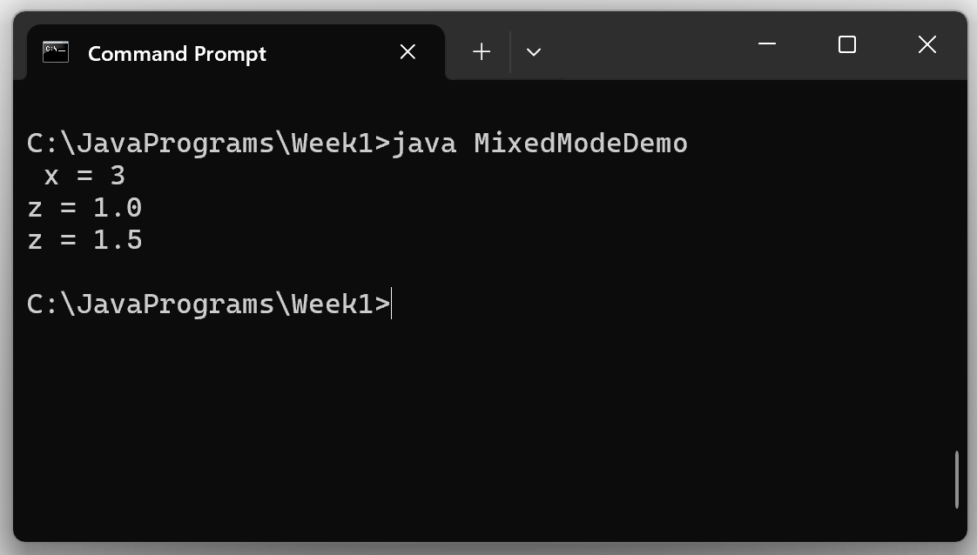
Java Type Conversion

Slide 21
Java Type Conversion
You can assign a variable that is less accurate to a variable that is more accurate
e.g., float_variable = integer_variable
You cannot assign a variable that is more accurate to a variable that is less accurate
e.g., integer_variable = float_variable

Slide 22
Explicit Casts
You must use an explicit cast operation to convert a more accurate variable to a less accurate variable
This should always be done with care since information is usually lost
LessAccurateType = (type) MoreAccurateType

Slide 23
Casting to Less Accurate Type
// Program to test mixed mode conversions
//
// Program Output: x is 99999
class MixedMode2
{
public class main( String [] args )
{
int x;
double d = 99999.99;
x = (int)d; // OK – d is cast to int
System.out.println(“x is “ + x);
}
}

Slide 24
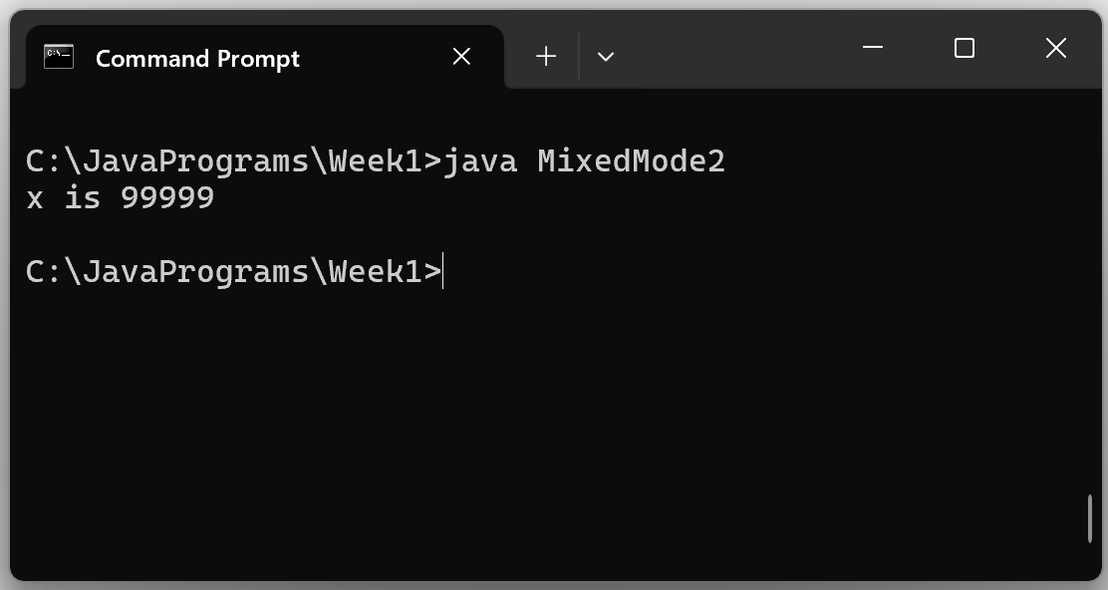
Casting to Less Accurate Type

